Slide 1


Testing process methodology
ADM SIT – BNP Paribas

Slide 2
Documentation analysis

Slide 3
Requirements analysis
Ask the BA for all analysis documents existent for the application
Analyze all the documents: FEX, FCU, User Stories, Chart Graphique, mock-ups, UI guidelines, technical specifications etc. -> this will help you better understand the application from a functional point of view
Look for: Completeness, Clearness, Correctness, Consistency and Testability of the requirements received (4Cs, 1T)
Ask for clarifications (BA/MOA/MOE and not the DEV)
Ask yourself about:
Function (what the product does): What are its functions? What kind of error handling does it do? Does it do anything that is not visible to the user?
Operations (how it will be used): Who will use it? Where and how will they use it? What will they use it for? Are there certain things that users are more likely to do?
Data (what it processes): What kinds of input does it process? What does its output look like?
Structure (what the product is): Is it one program or many? Can I test it module by module?

Slide 4
Writing test cases

Slide 5
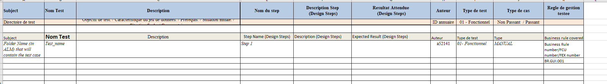
Test plan creation – integration test cases
- Use the attached template to write the test cases
- Cover all business rules and requirements
- Ensure that all positive scenarios AND negative scenarios are covered.

Slide 6

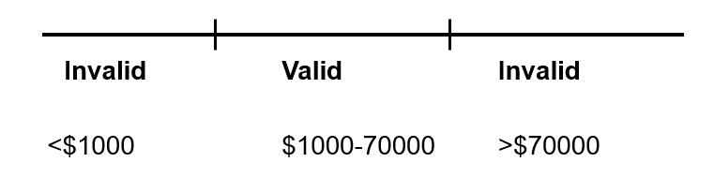
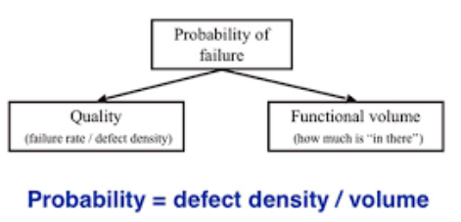
Black-box testing techniques to be used
Boundary testing
Equivalence classes
Decision tables
Risk Analysis
Create test cases at the boundary of each input:
Just below the boundary;
Just above the boundary;
Identify equivalence classes, the input values which are treated the same by the software:
Valid classes: legal input values;
Invalid classes: illegal or unacceptable input values;
Useful in systems where combinations of input conditions produce different actions
A way to capture system requirements that contain logical conditions
Relation between cause and effect
Imagine how the program could fail
Design test cases to expose these potential failures
A way the program could fail

Slide 7
Test plan creation – non-regression workflows
Use the regression testing after : enhancements, error corrections, optimization and deletion of existing features
Use the same attached template to write the test cases for the main workflows
Make sure to cover all workflows and main functionalities of the application
Include in the test cases combinations of multiple, different scenarios that might be done in the application

Slide 8
Testing traceability

Slide 9
HP ALM – prerequisites
ask for rights on the selected project (or make sure that you have the rights) and on the following functionalities:
Test Plan
Test Lab
Requirements
Management
Defects
create the test plan using the EXCEL template

Slide 10
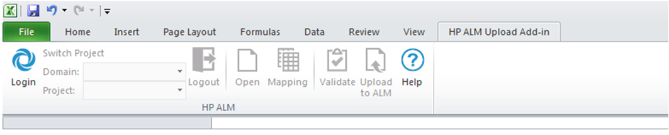
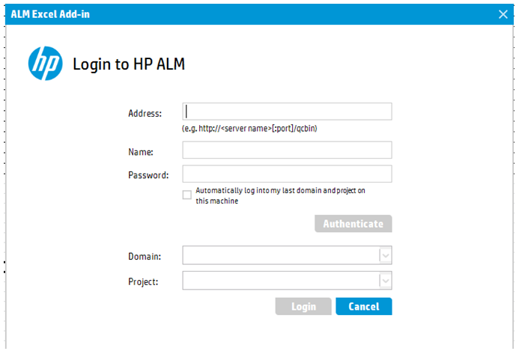
HP ALM – upload tests
Install the HP ALM add-in (After that, it can be seen as a new tab in Excel)
Click on Log in – will open an ALM page to introduce user + password and to choose the domain/project where you want to upload the test cases
Upload the test plans written in the template Excel given into ALM using the mapping file attached.

Slide 11
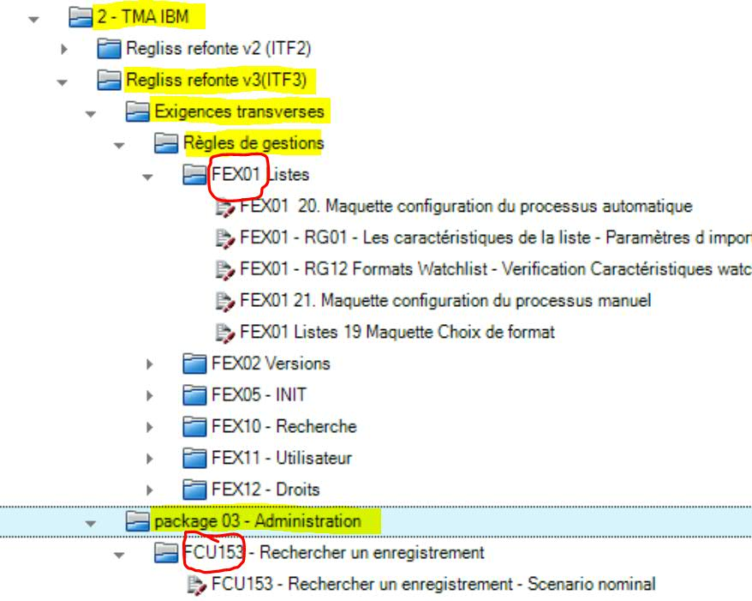
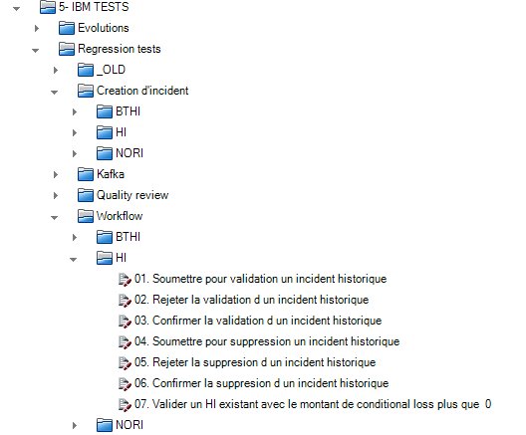
HP ALM – Test Plan
Remark: In ALM the tests uploaded can be found in Test Plan part, in the folder whose name corresponds to the “Subject” column in the Excel template
Don’t forget to upload the non-regression test plans too – in a separate folder
Create an identical structure in Test Lab like for Test Plan
Verify that all the Steps and Test Cases (TCs) were correctly imported
IF NECESSARY: move the imported TCs in other folders (in ALM)
Structure examples:
Integration test cases:
Non-regression test cases:

Slide 12
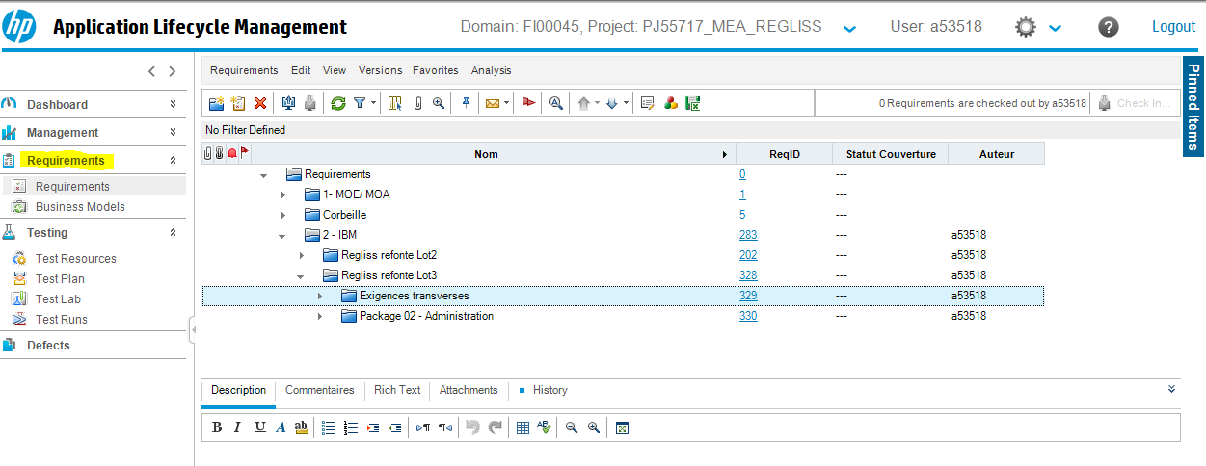
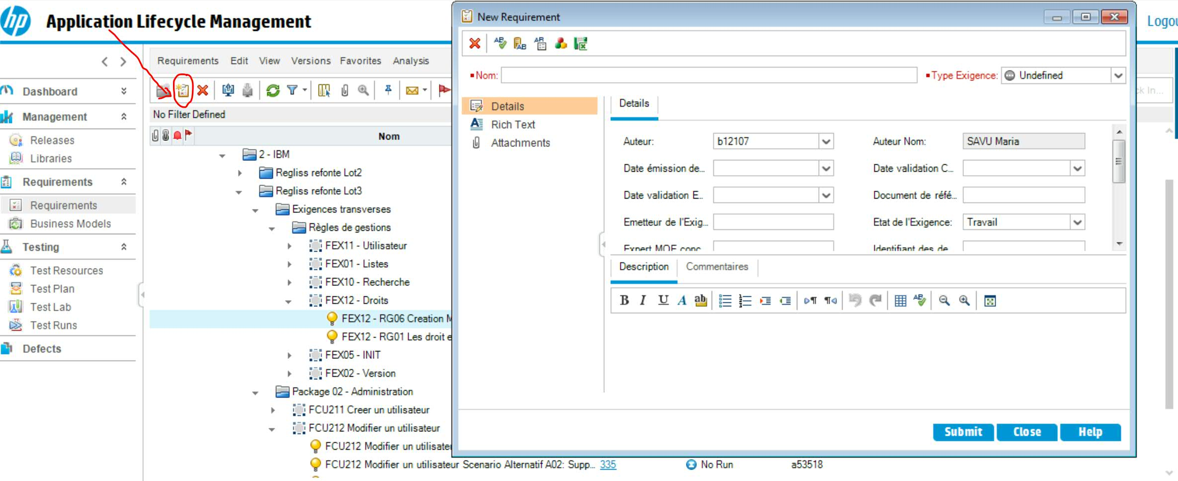
HP ALM – requirements traceability
- click on <Requirements > in the main menu with the same name
- (Optional) Create the folders in the same order as they appear in the Test Plan (for a better/easier view&understanding)
- For every main folder click on <New Requirement> in order to add the Business Rule/FEX/FCU number/name

Slide 13
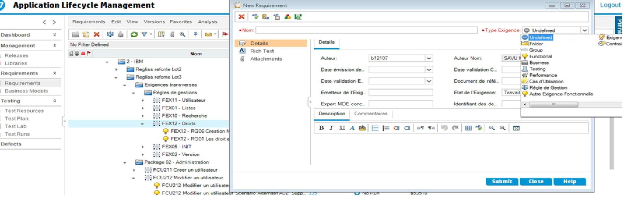
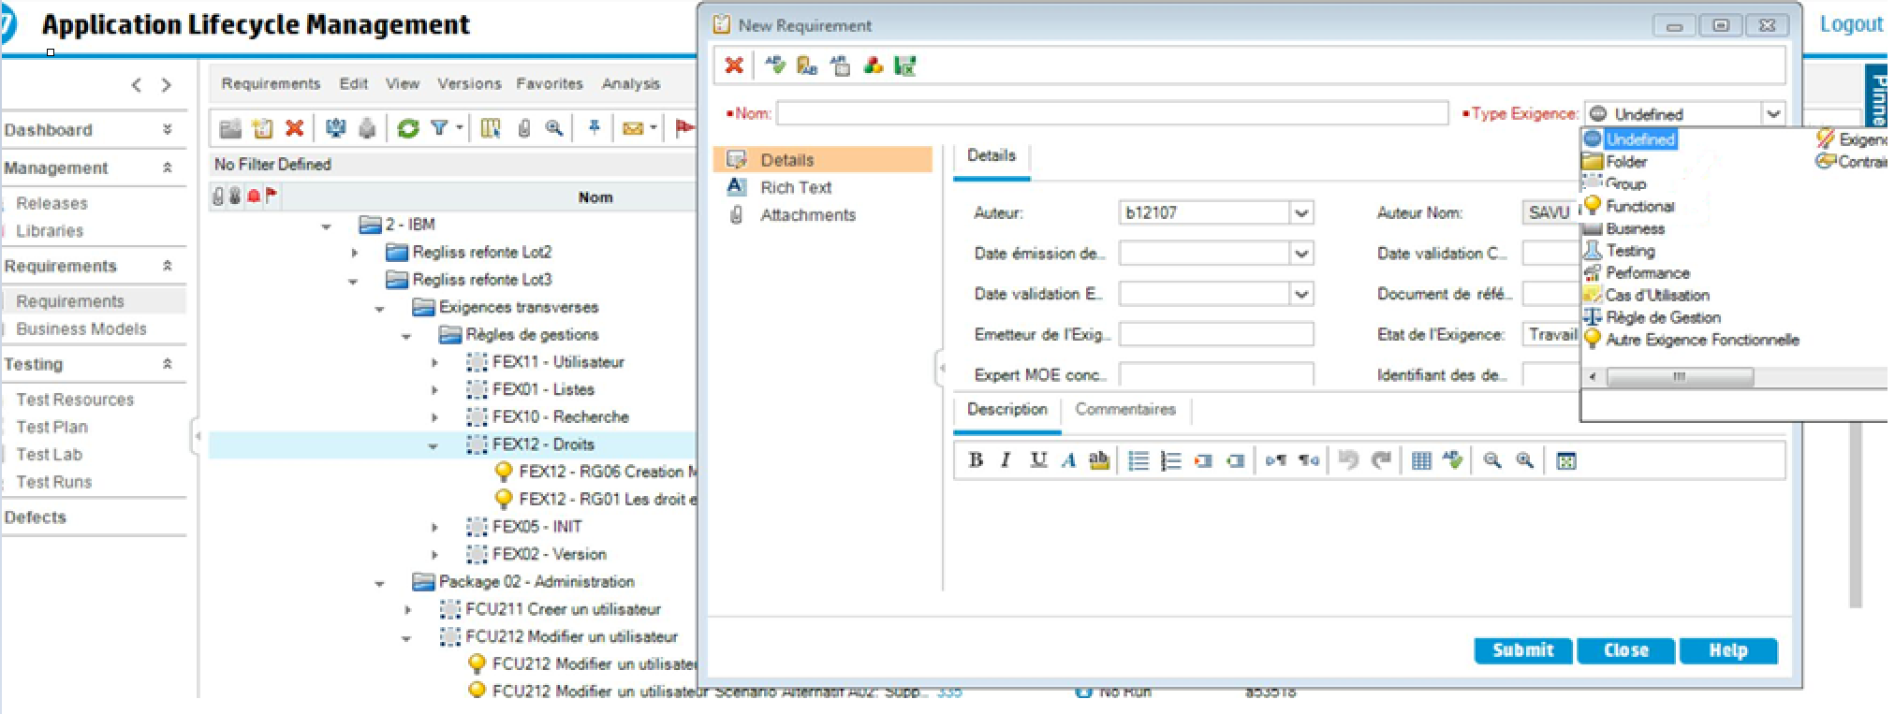
HP ALM – requirements traceability
- Select the <Type Exigence> - ‘’Group’’ in order to create a group for each US/FEX/FCU
- Select the <Type Exigence> - ‘’Functional’’ in order to create a function for each Business Rule

Slide 14
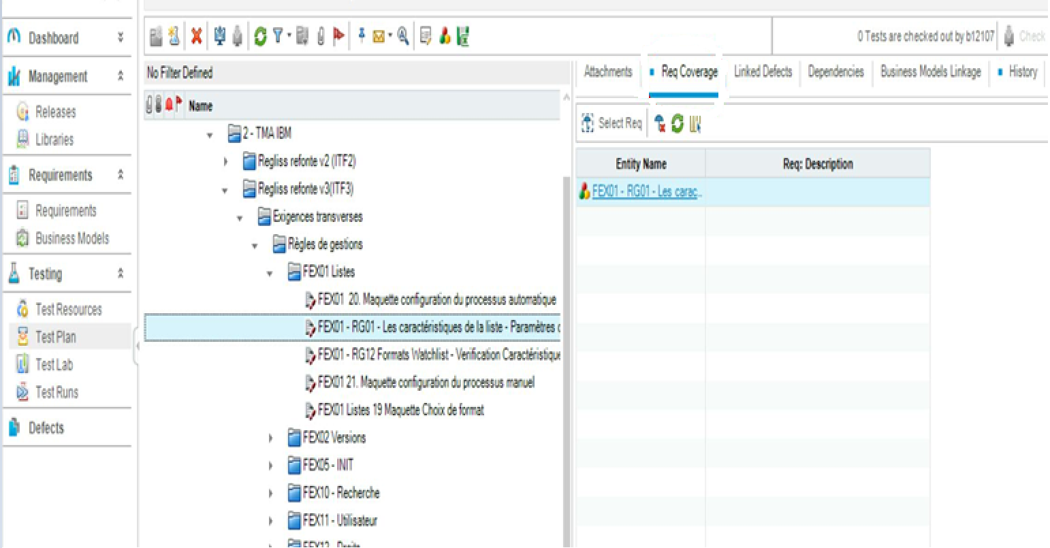
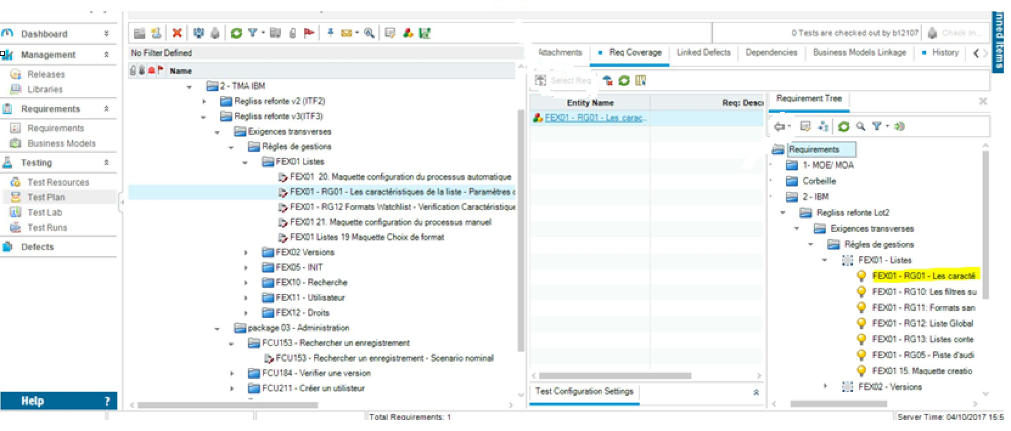
HP ALM – requirements traceability
Link Requirements to the tests:
Go to <Test Plan> and for For every TC created:
Click on the test
Click on the tab <Req coverage>
Click on <Select Req> - The ‘’Requirement Tree’’ is shown
Select the requierement in it and click on the arrow to the left

Slide 15
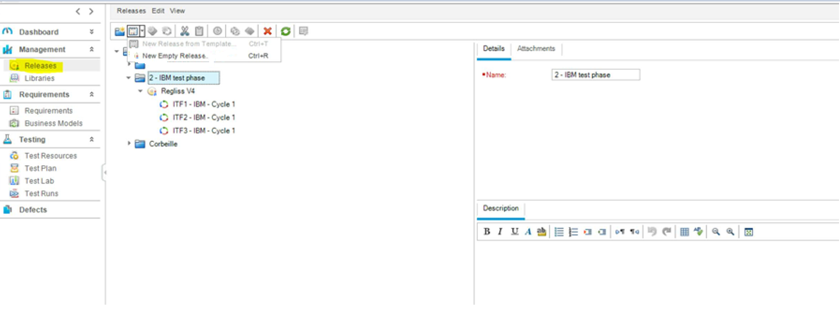
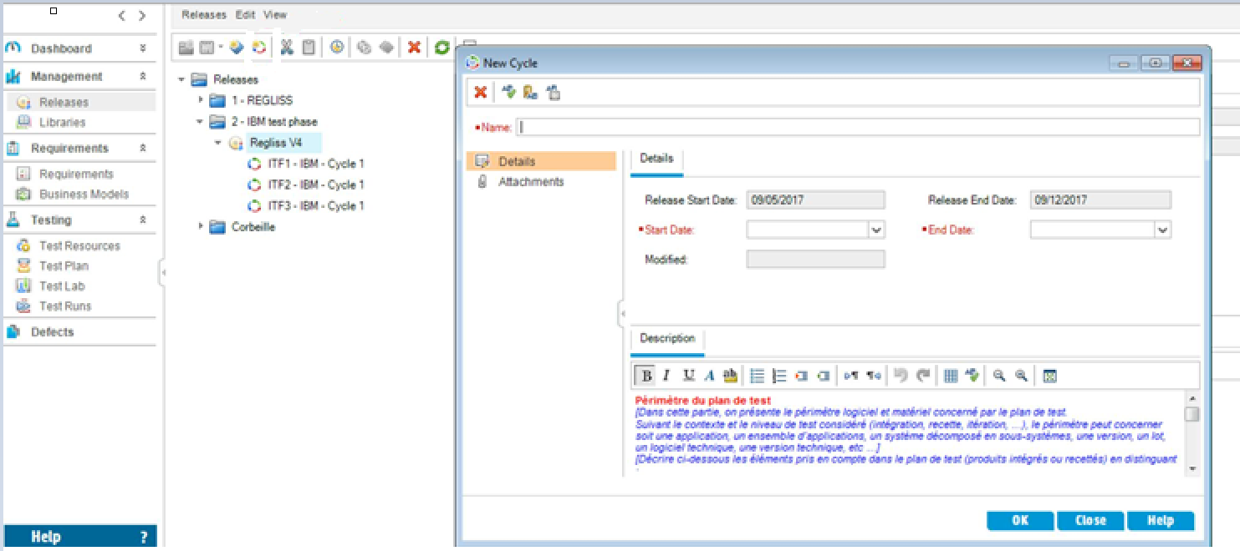
HP ALM – create cycles for each iteration/sprint
Select in the <Management> main tab the <Releases> function
(Optional) If necessary create a new folder
Click on the folder and select the <New empty release> function
Choose a <Name> for the Release (the application name )a <Start Date> and <End Date> estimated
Click on the release created
Click on create <New Cycle>
Choose a <Name> for the Cycle (e.g. Sprint x ), a <Start Date> and <End Date>

Slide 16
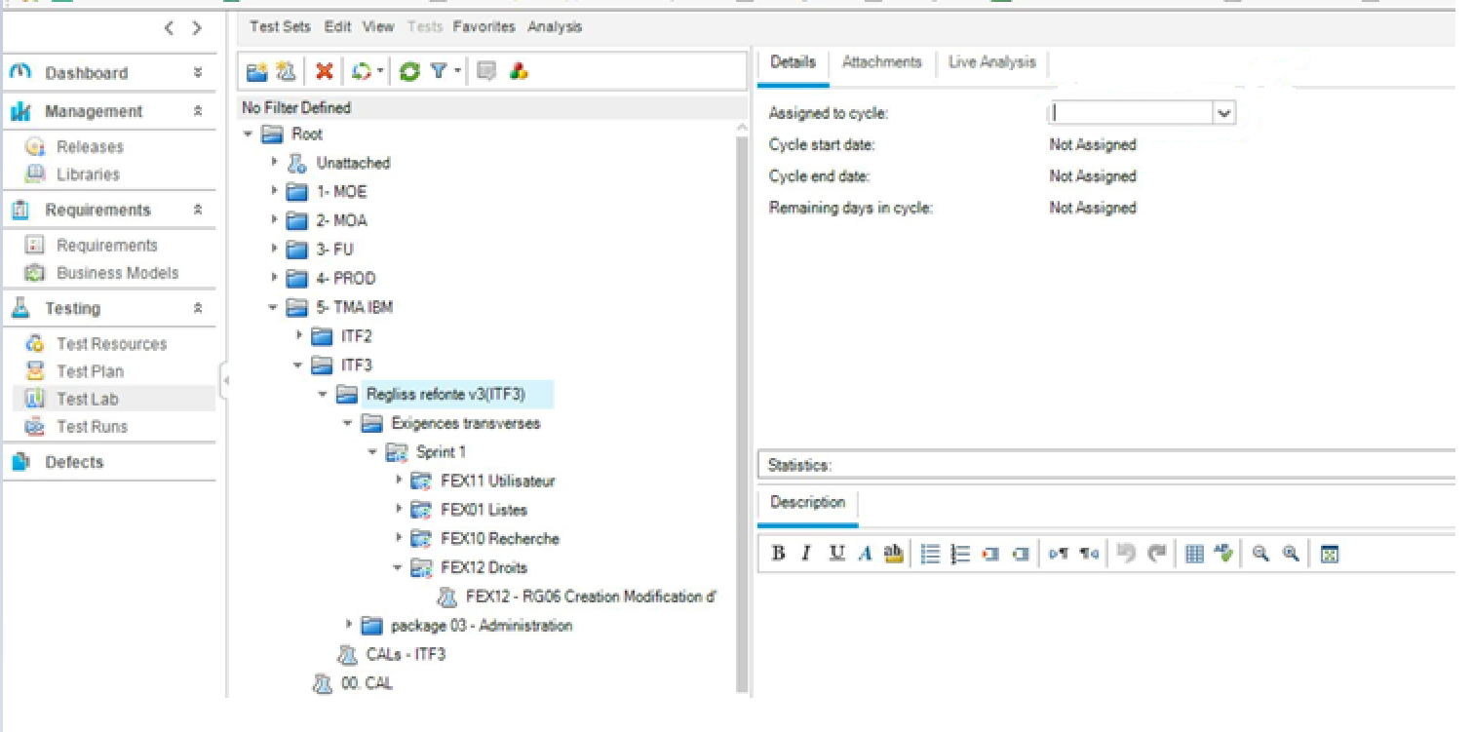
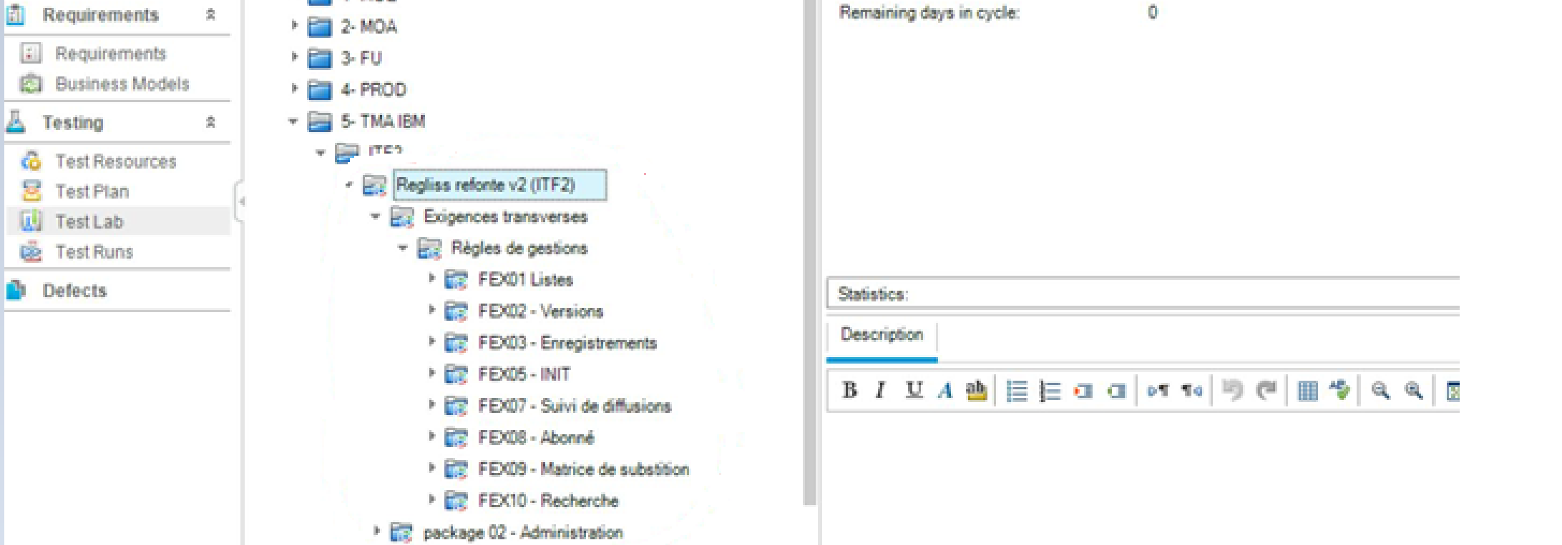
HP ALM – create cycles for each iteration/sprint
Add Release and Cycle to Test Lab
Go to <Test Lab> in the main menu
Select the folder that contains the iteration that must be assigned to the cycle created (In scope to test the functionalities selected in this cycle)
Click on it and in the <Details> tab click on <Assigned to cycle>
Choose the Cycle created that must be assigned to the sprint
Automatically the cycle will be assigned to all the sub-folders of the main folder selected

Slide 17
HP ALM – create release and cycles for each non-regression testing session
Non – regression testing sessions have to be traced accordingly in HP ALM, so that we can easily identify when they were run and the sprints/functionalities for which we have run the non-regressions tests
Release:
<Name> for the Release : Non-regression Tests + application name
<Start Date>: the estimated start date of the project/release
<End Date> : the estimated end date of the project /release
Cycles (3 sprints to be tested):
<Name> for each cycle: should include the name of the last 3 sprints for which we do the TNR
<Start Date> the start date of the first sprint to be included in the TNR testing session
<End Date> the end date of the third sprint to be included in the TNR testing session

Slide 18
Test execution

Slide 19
Test case execution
Start testing the application and veryfing all the business rules/ functional specifications/ workflows/ functionalities
Create the Test Evidences document for the scenarios executed
Register every bug found – printscreens and how can it be reproduced (steps)
Run the test cases in ALM in the Test Lab part

Slide 20
Defect reporting

Slide 21
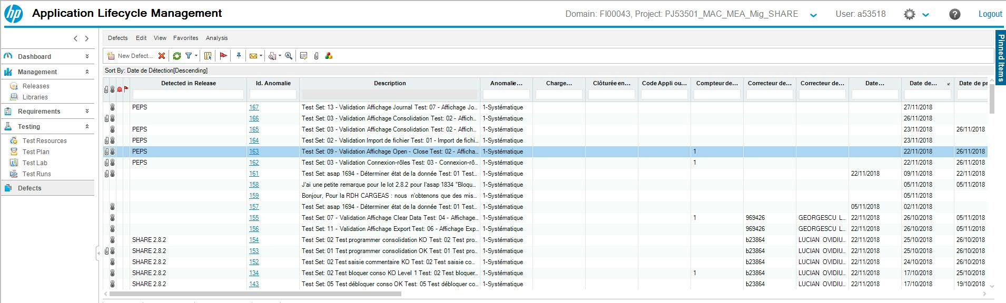
Defect logging and test reporting
Register every bug found in a word document– also including printscreens and details on how to reproduce the bug
Register the bugs in ALM
Send to the whole team the remarks file to make the process transparent (including the french team)

Slide 22
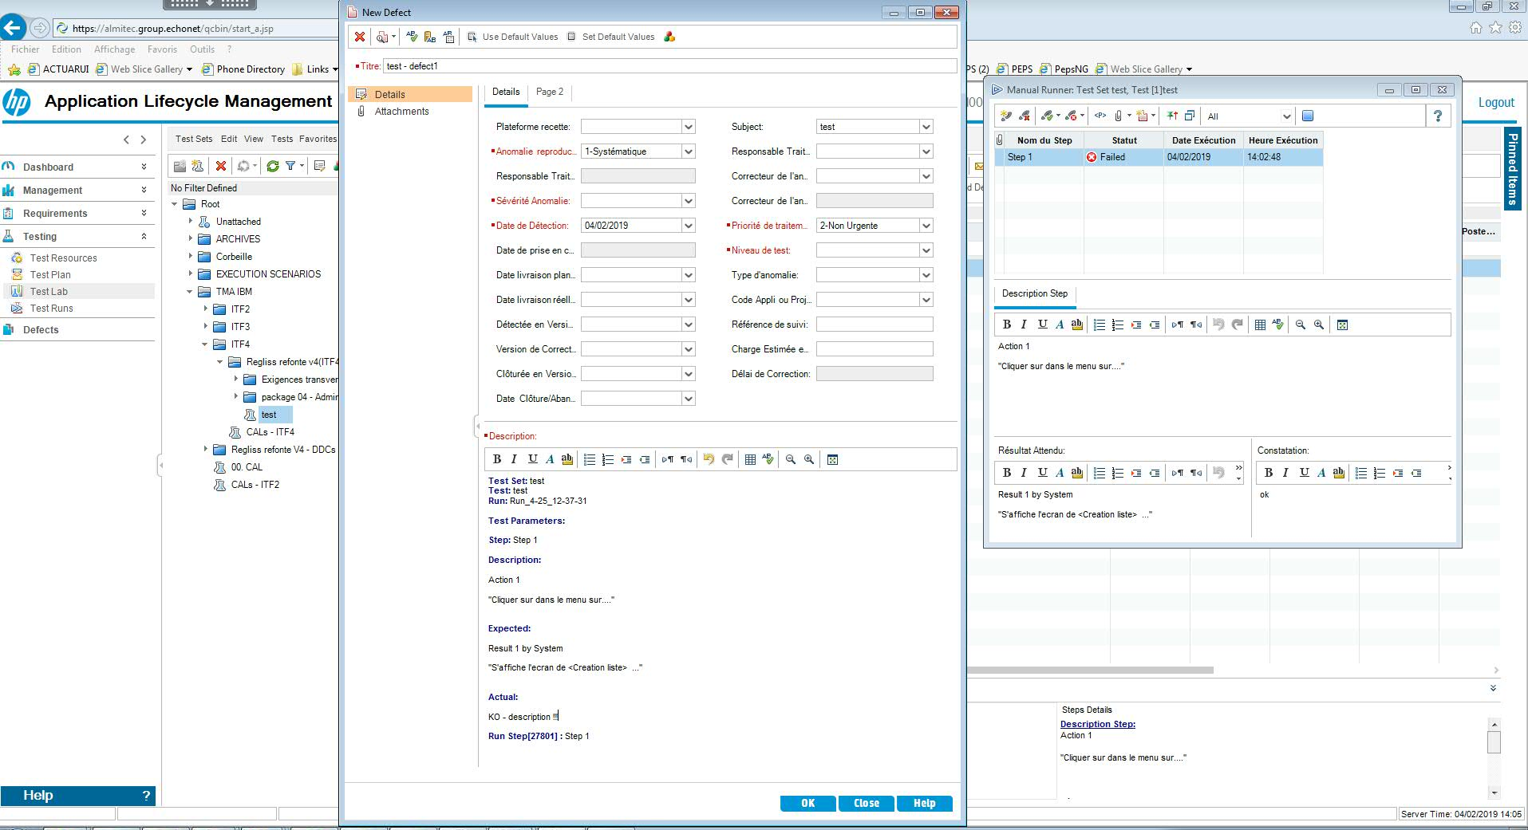
Defect logging and test reporting : ALM – bug registration
2 ways to create a defect:
Create a defect when running the tests in <Test Lab>
Create a defect directly form the <Defects> tab
When creating a new defect:
Fill in the mandatory fields when creating a new defect (<Severity>, <Test level>, <Title>)
Add the screenshots or other evidence files in <Attachments> tab
Advice: explain the actual behaviour (how the bug looks like/how to reproduce it) vs. expected behaviour

Slide 23
Test reverification and confirmation

Slide 24
Defect fix reverification and confirmation reports
Retest the bug fixed
Using the Test Evidence doc template, add screenshots to confirm the fix
Execute the non regression tests in order to make sure the modification has no impact on other functionalities
Send the document to the team to confirm the fix

Slide 25
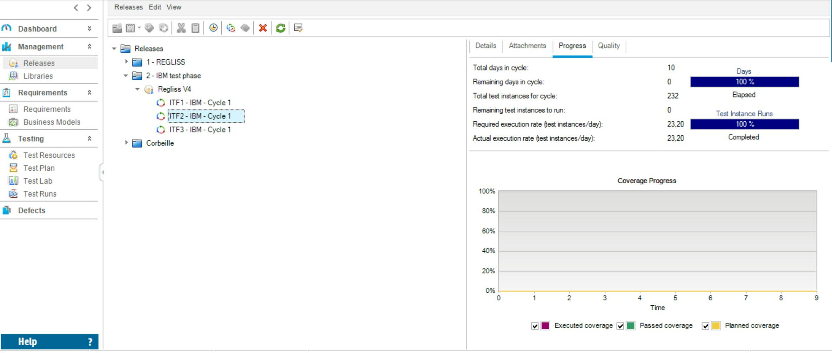
See testing progress and reports – HP ALM
HP ALM allows to see the progress of the execution(runs) of the test cases from Test Lab for each Cycle created.
You can check the testing session statistics in <Releases>, for each cycle/release created, the <Progress> tab

Slide 26
ALM Defects Analysis

Slide 27
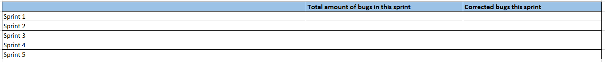
ALM Defect Tickets tracking
Keep track of the defects in ALM using the Excel File template attached
Introduce in the Excel template the number of defects from ALM, in two categories, in the table created :
Defects opened in a certain sprint
Defects fixed in that sprint

Slide 28
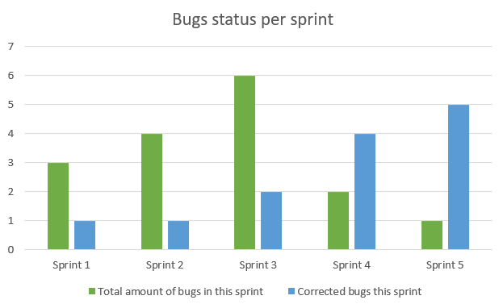
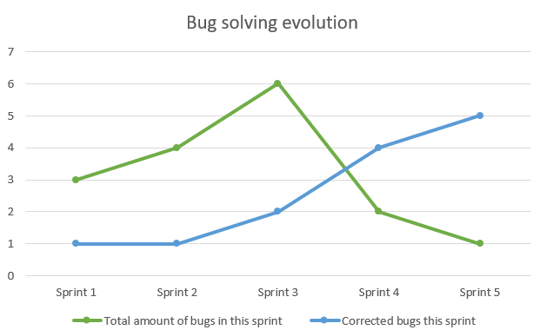
ALM Defect Tickets tracking -example
After filling in the table, 2 graphics will allow to a better visibility of the testing phase on a certain application

Slide 29
Don’t forget
At the end of every week , an email has to be sent to the Test Lead and also to the Team Lead/Projet Manager of the application you are working on
All encountered problems have to be told immediately or as soon as possible (to the Test Lead, Team Lead, Project Manager) via email. That means environment issues, servers down, blocking points, functionalities not developed, missing documentation, uncovered business requirements before the demo or any other problems.
To ask PO/BA/MOA/MOE if you have gaps/questions regarding the documentation, on email.
To ask for the update of the documentation if business rules change during time.

Slide 30


